Slide 1
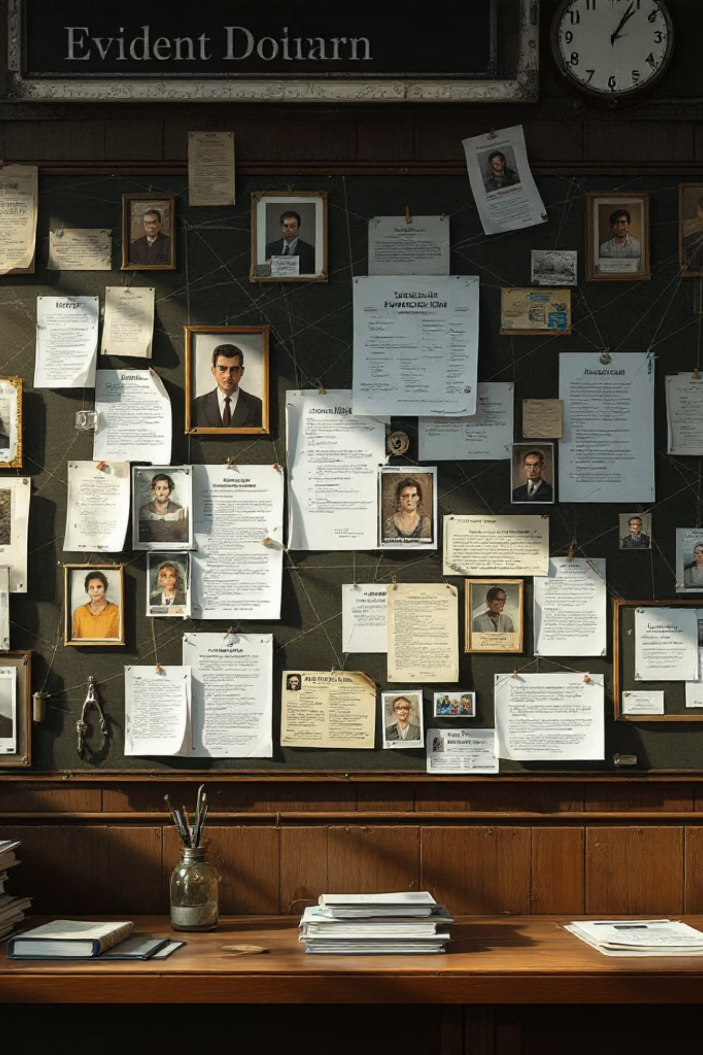
Graph-Based RAG for Legal Case Analysis
Structured Information Extraction and Reasoning over Court Decisions

Slide 2

The Complexity Crisis
High Stakes
Scalability
Missing a single cross-reference can lose a case. Legal accuracy is not aspirational — it is the baseline.
Data volumes have outpaced human-only research. Attorneys cannot manually trace citations across millions of documents.
🎯 Precision
Verbatim citations are non-negotiable. Approximate or hallucinated references carry serious legal and professional risk.

Slide 3
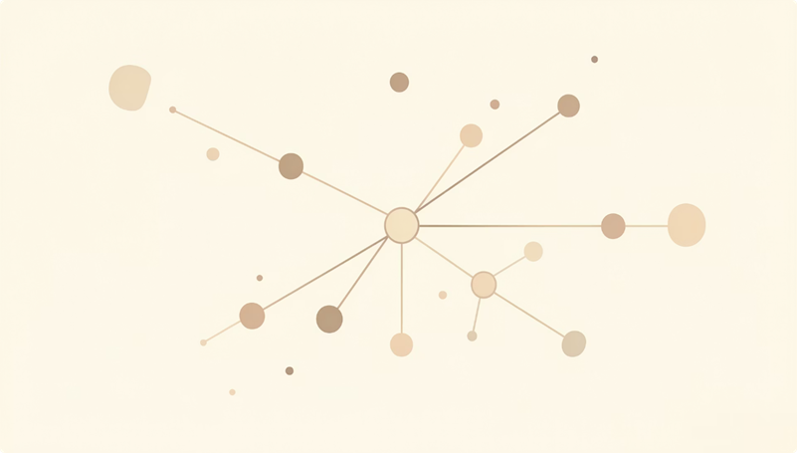
Why Standard RAG Is Not Enough
Semantic Similarity Only
Isolated Chunks
Documents are treated as independent chunks
Retrieval is based on semantic similarity, not legal structure
Multi-Hop Limitation
Citation Risk
Limited support for multi-hop reasoning across cases
High risk of incorrect or incomplete citations
The Gap
Legal reasoning requires structured relationships, not just similar text

Slide 4

Knowledge graphs
By modeling legal data as a graph, we preserve the topology of law.
Each node represents a legal concept, and each edge is a defined
legal relationship.
This allows the LLM to "walk" the graph to find evidence,
ensuring every claim is grounded in a specific node with
a verifiable metadata source.

Slide 5
Legal Question Answering with Grounded Evidence
01
02
03
Input
Processing
Output
Legal question and corpus of legal documents (graph-structured)
Graph traversal and multi-hop reasoning
Natural language answer with supporting evidence
Supporting Evidence Includes:
Example
Cited cases
Relevant statutes
Reasoning path (subgraph)
Q: Which cases citing Statute X were later overturned?
A: [Answer] + [List of cases] + [graph-based reasoning chain]

Slide 6
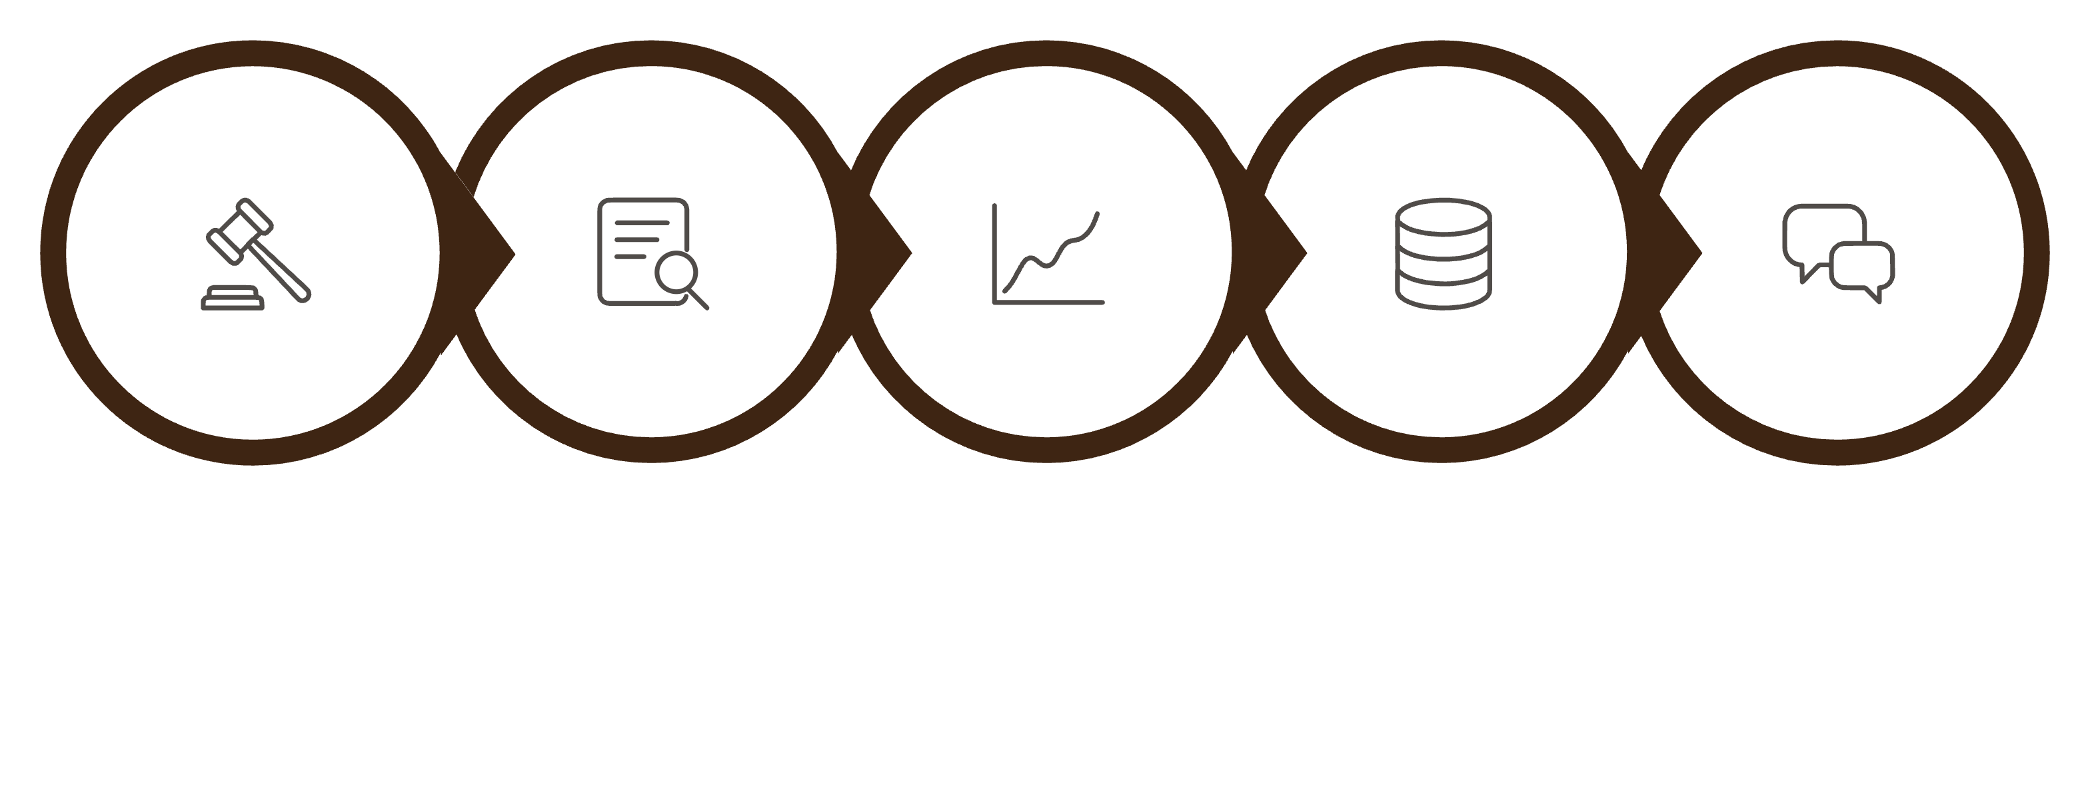
Proposed Pipeline
Graph Construction
Court Decision
Information Extraction
Graph-Based Retrieval
Answer & Explanation

Slide 7
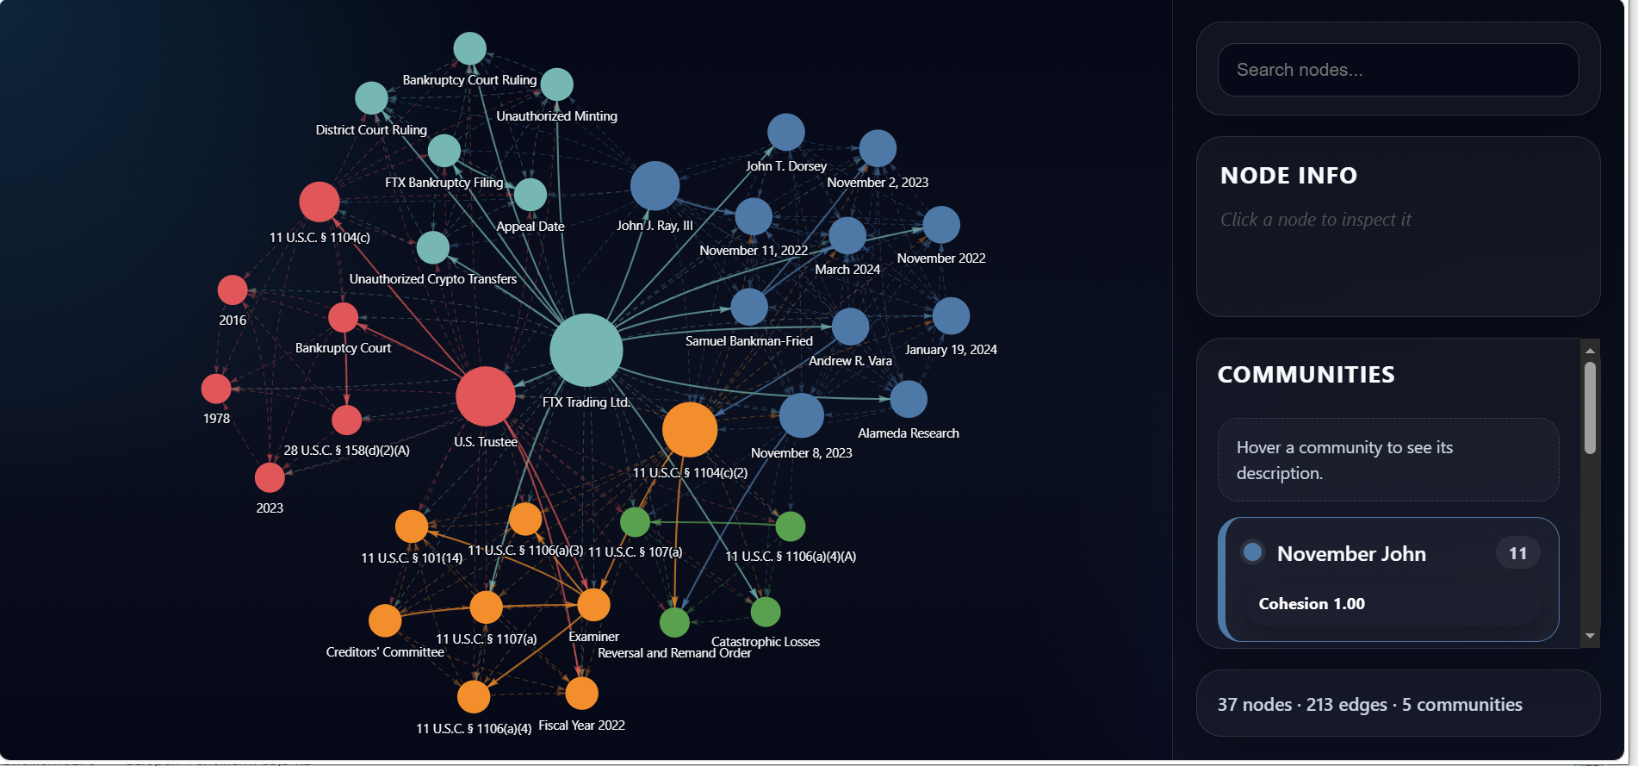
Example :

Slide 8
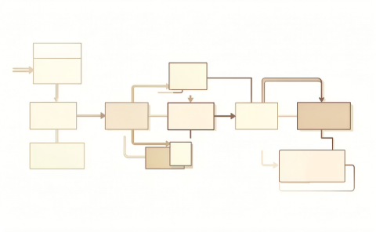
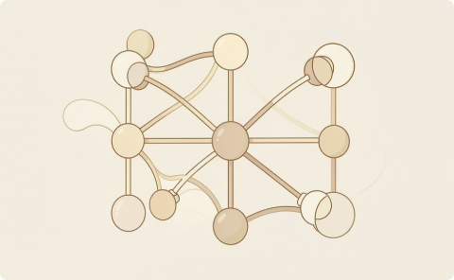

Technology Stack
Orchestration
Graph Store
LLM Engines
LlamaIndex & LangGraph - orchestration
Neo4j provides high-performance Cypher queries and persistent relationship storage across the full legal corpus.
GPT-4o / Claude 3.5 for cloud reasoning and generations .
Mistral - local processing.

Slide 9
Evaluation Framework
Metric Type
Definition
Faithfulness
Is the answer derived 100% from retrieved subgraphs?
Answer Relevance
Does the response directly address the legal question?
Citation Accuracy
Are page/section citations correct and verifiable?
Multi-hop Precision
Ability to retrieve secondary tertiary linked cases.

Slide 10

Synthetic Data Generation
Challenge: Lack of Labeled Legal QA Data
1
2
Source Material
Generation
Use real legal documents as source
Generate synthetic question–answer pairs, reasoning chains, and supporting citations
3
Quality Control
Filter low-quality samples using LLM validation
Controlled generation: Vary question types (fact, reasoning, comparison) and enforce structured outputs (JSON format)

Slide 11

Baselines
We compare against:
1. Zero-Shot LLM
2. Standard Vector RAG
3. Graph-Based RAG (Ours)
No retrieval
Goal: Measure improvement from structured retrieval

Slide 12
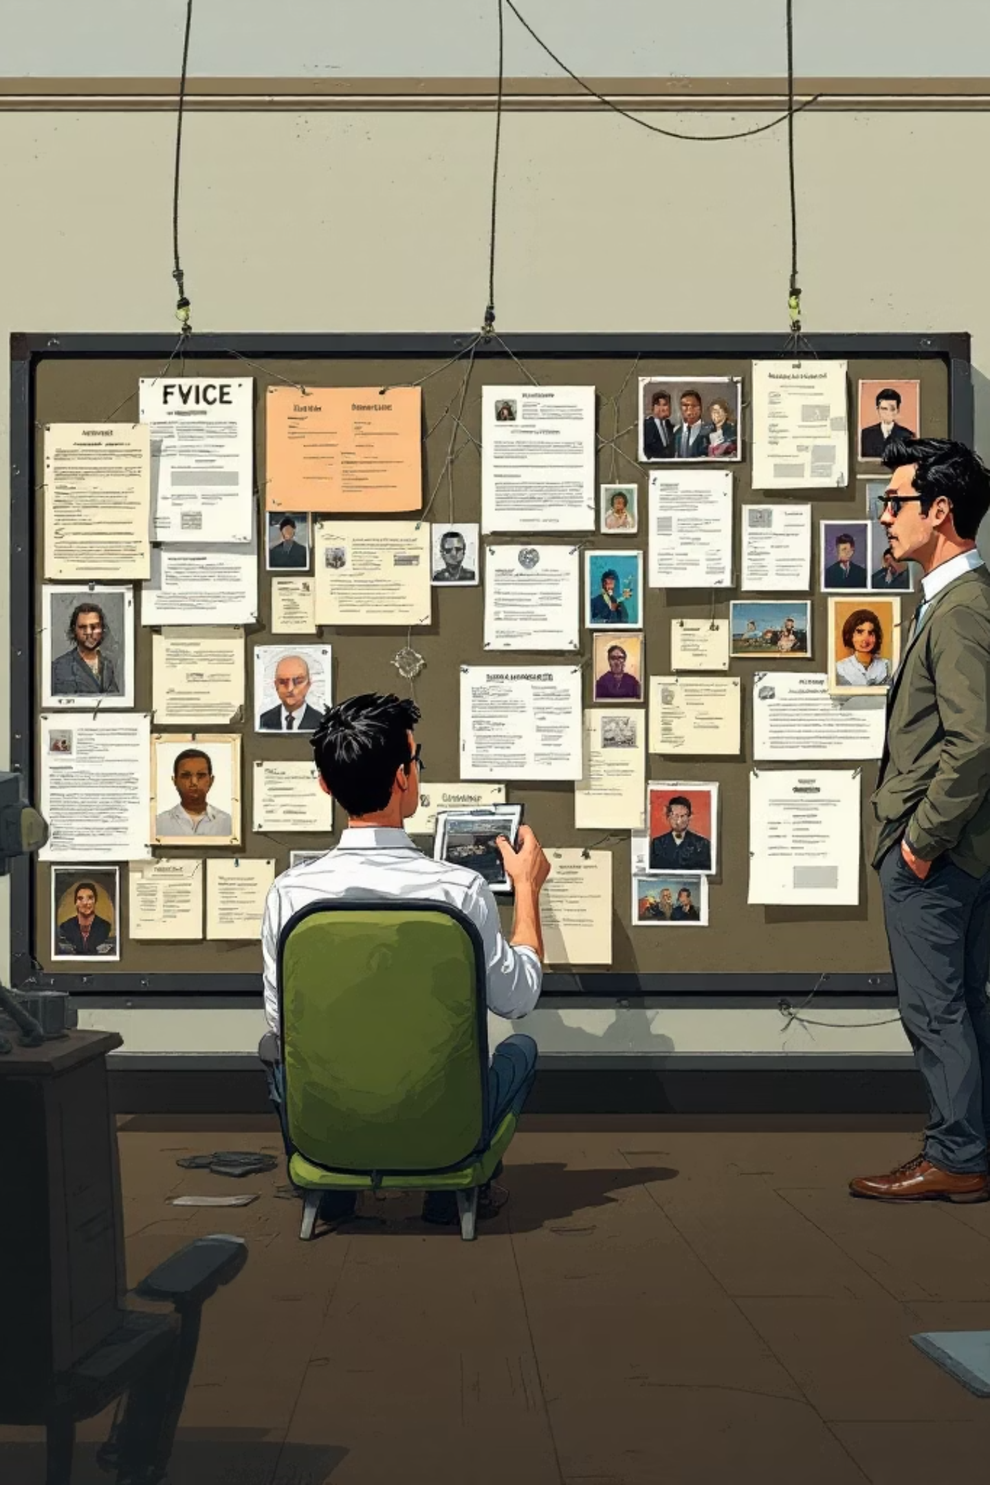
Conclusion
Graph-based RAG transforms legal case analysis by preserving structural hierarchy and enabling multi-hop reasoning over legal precedents.
By grounding every claim in verifiable node metadata, we eliminate hallucinations whilst maintaining the precision required for high-stakes litigation.

